Slide 1
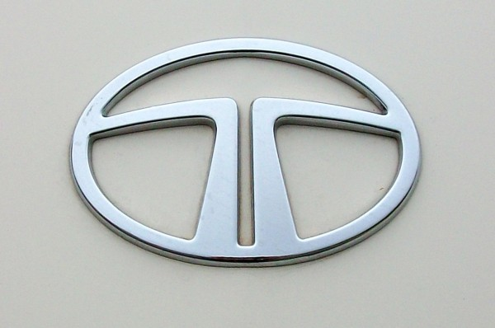
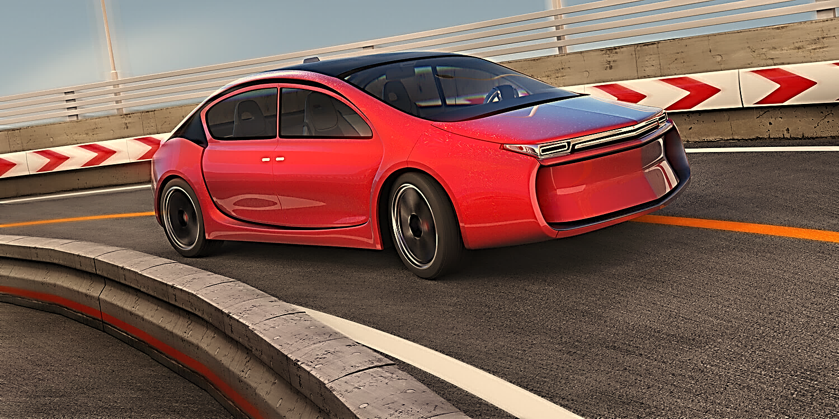

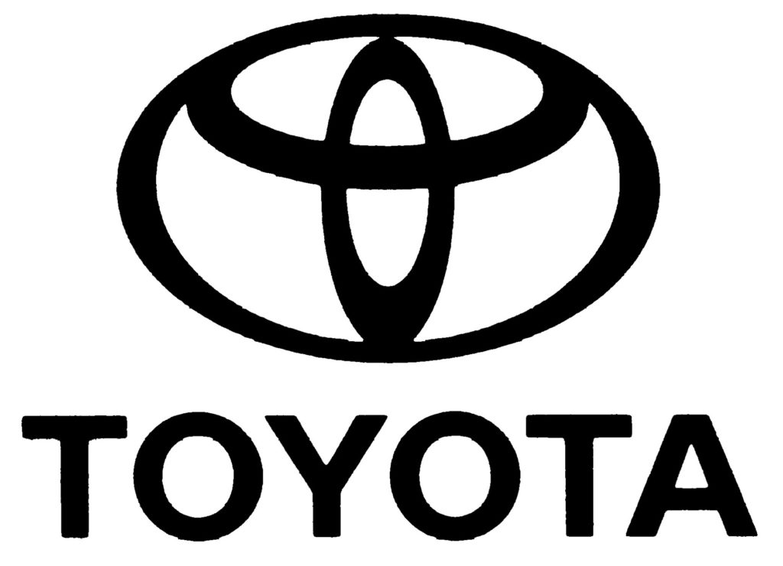
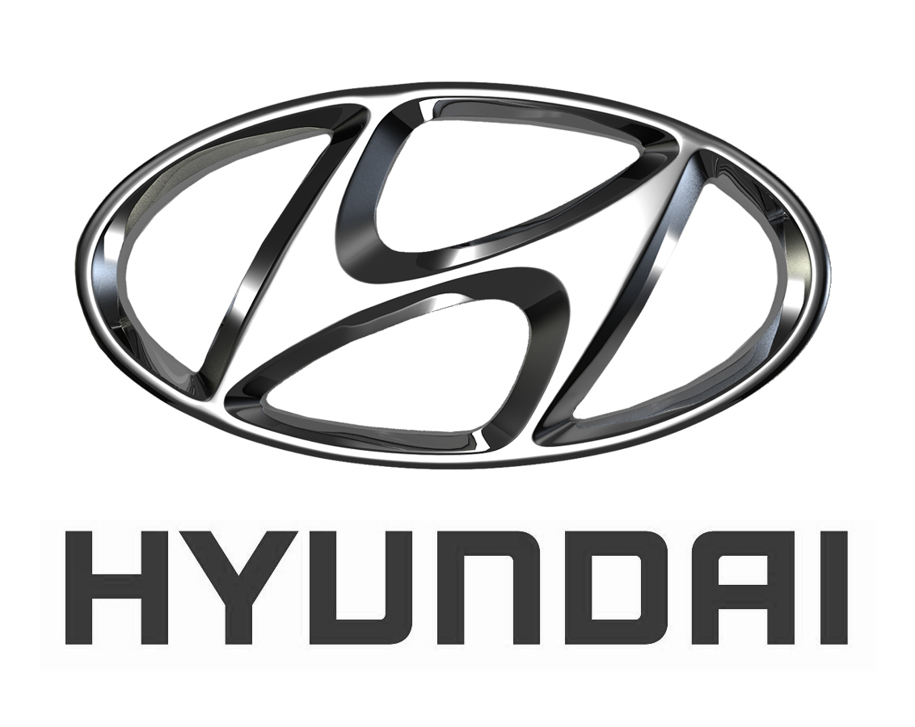



AUTO-INSURANCE ANALYSIS
May 2018
By: Deepa Kushwaha

Slide 2
Top 5 State by AVERAGE of IDV
Gujarat” has the highest value for “AVERAGE of IDV” (192810)
Gujarat
UTTAR PRADESH
192810
Maharashtra
187316
HARYANA
186548
186288
NCR
NCR has the lowest “AVERAGE of IDV”
185176

Slide 3

TATA INDICA is the largest Car Segment in India
NEWDELHI
Mrf Model Tata Indica, Growth in Top 5 cities.
New Delhi is the Largest Mrf of Tata Indica.
BANGALORE
CHENNAI
NOIDA
KOLKATTA

Slide 4
NCR Records Maximum Premium.
MAHARASHTRA Records Minimum Premium.

Slide 5

No. of Mrf Model Registered by Gender

